Slide 1
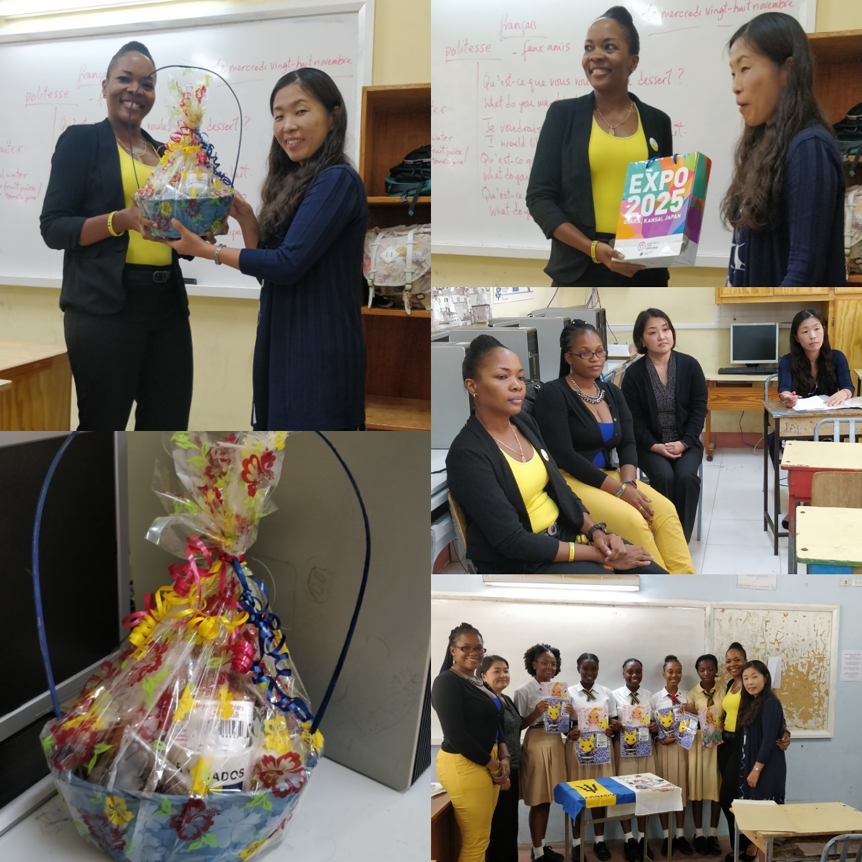
VISIT FROM MEMBERS OF THE JAPANESE EMBASSY

Slide 2
Preparation
On the 28th November 2018, the students of the Japanese Project were visited by members of the Japanese embassy.
In preparation, a speech on the history of Barbados was created to present to the members of the Japanese embassy.
The members also contributed money in order to prepare a gift for the visitors.

Slide 3
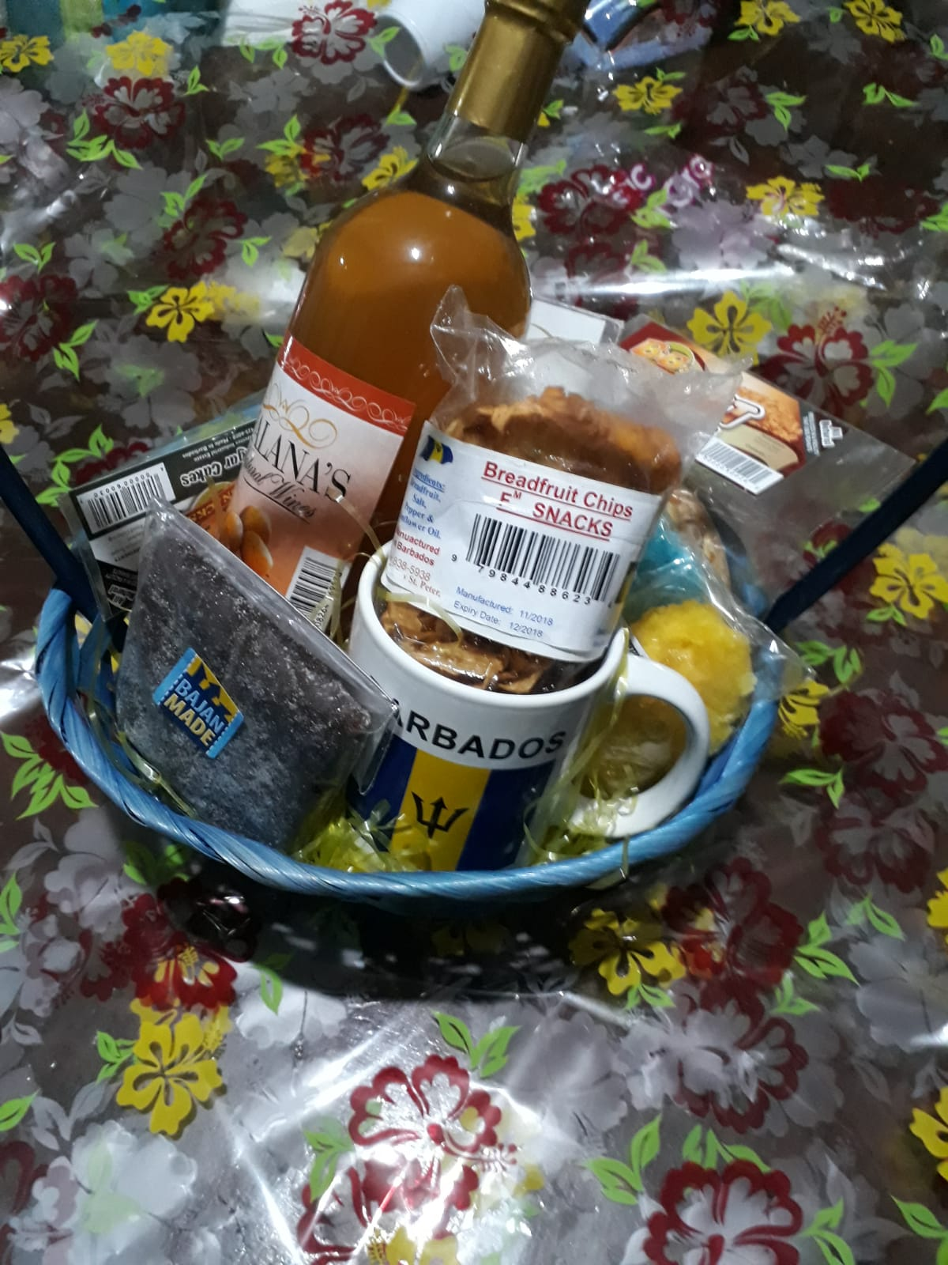
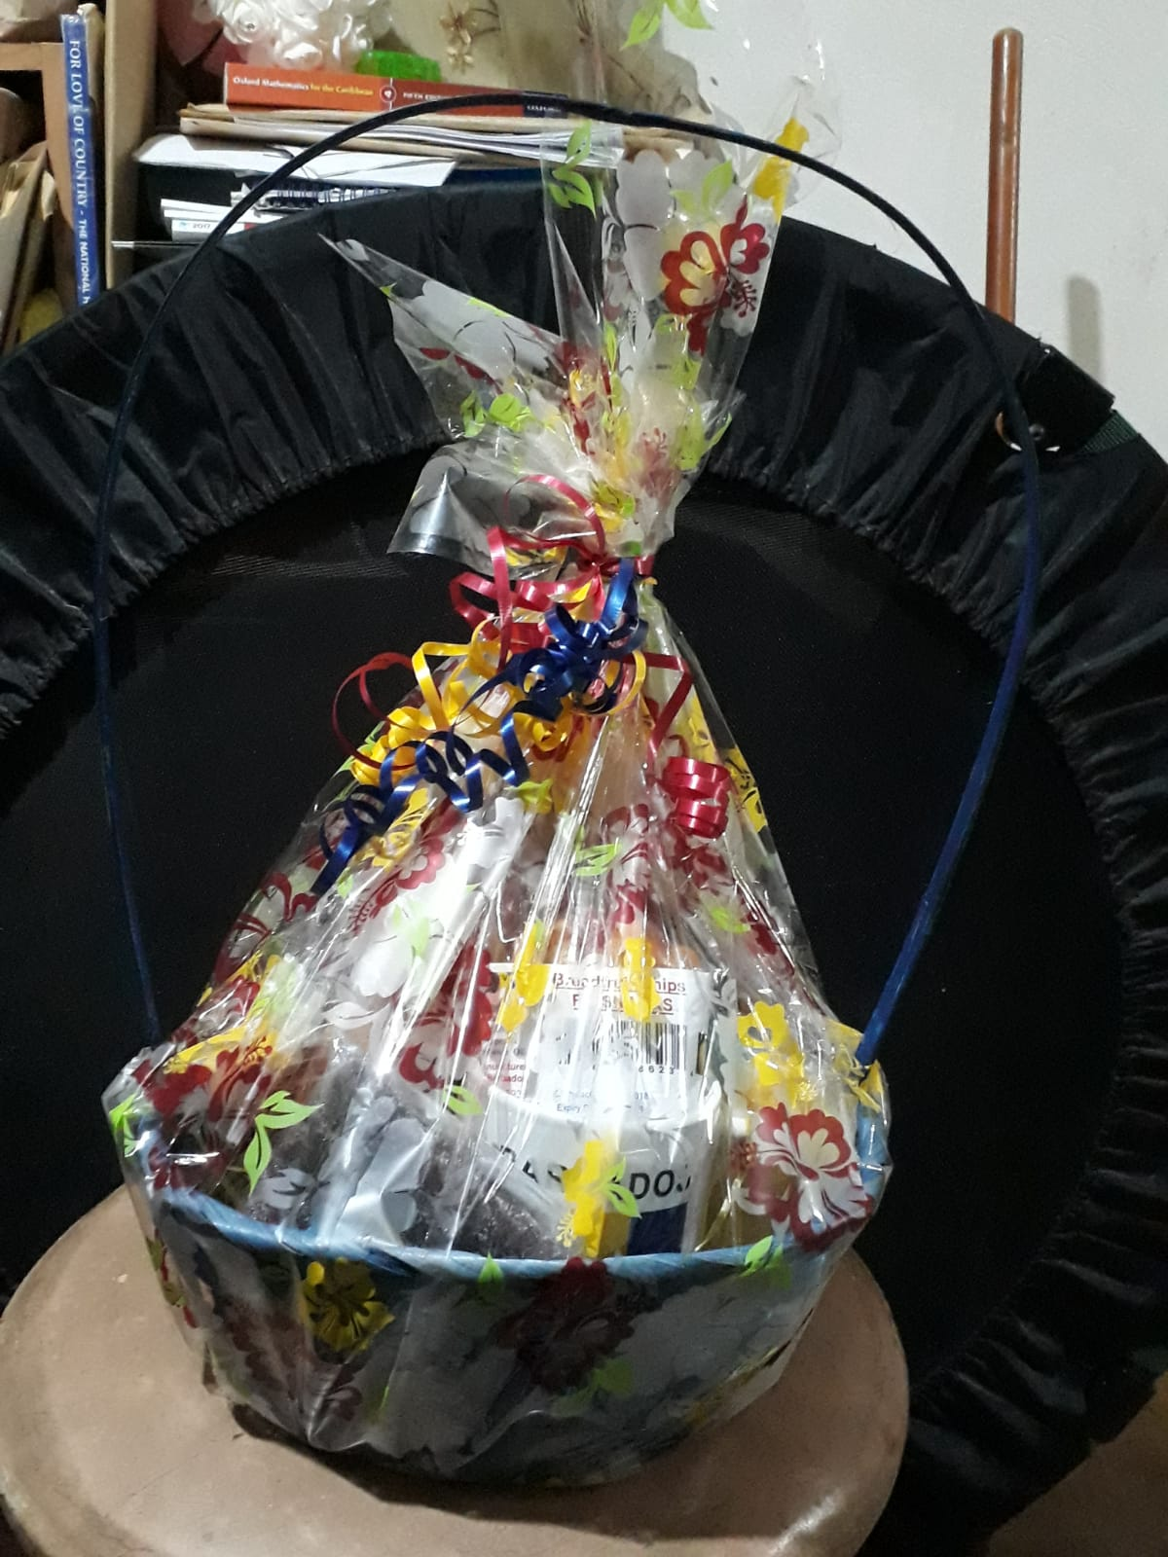
The Independence Gift Hamper
This hamper included many traditional Barbadian sweets such as tamarind balls, sugar cakes, breadfruit chips and wine.

Slide 4
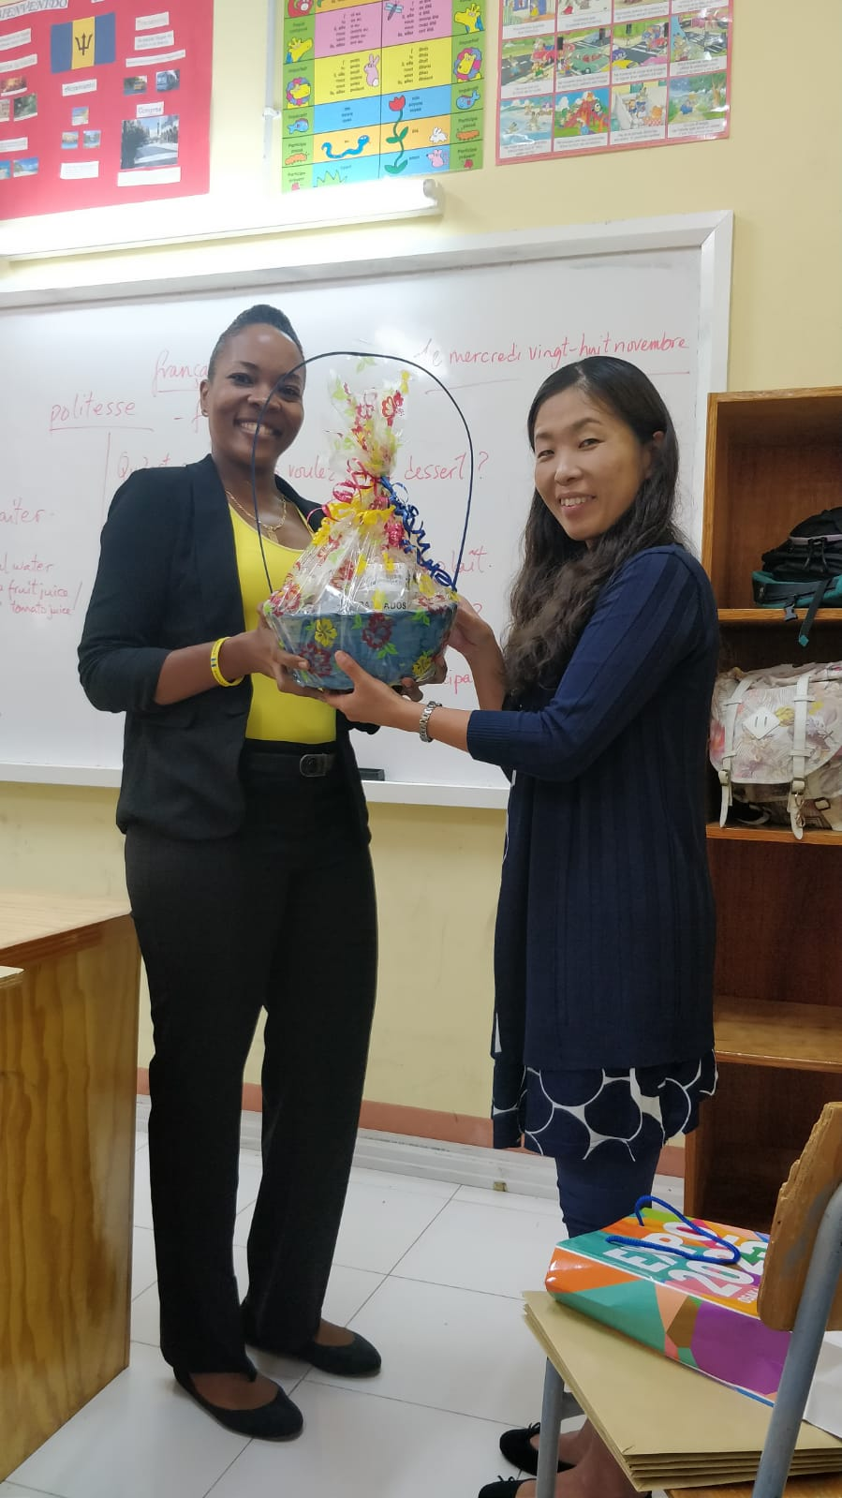
On the day
The meeting was scheduled to start at 12:15. As the visitors came around noon, we had time to socialize with them, showing them the work we had completed so far.
At 12:15, we began the presentation. We started with a brief history of Barbados and then presented the gift hamper to the Japanese embassy’s representative.

Slide 5
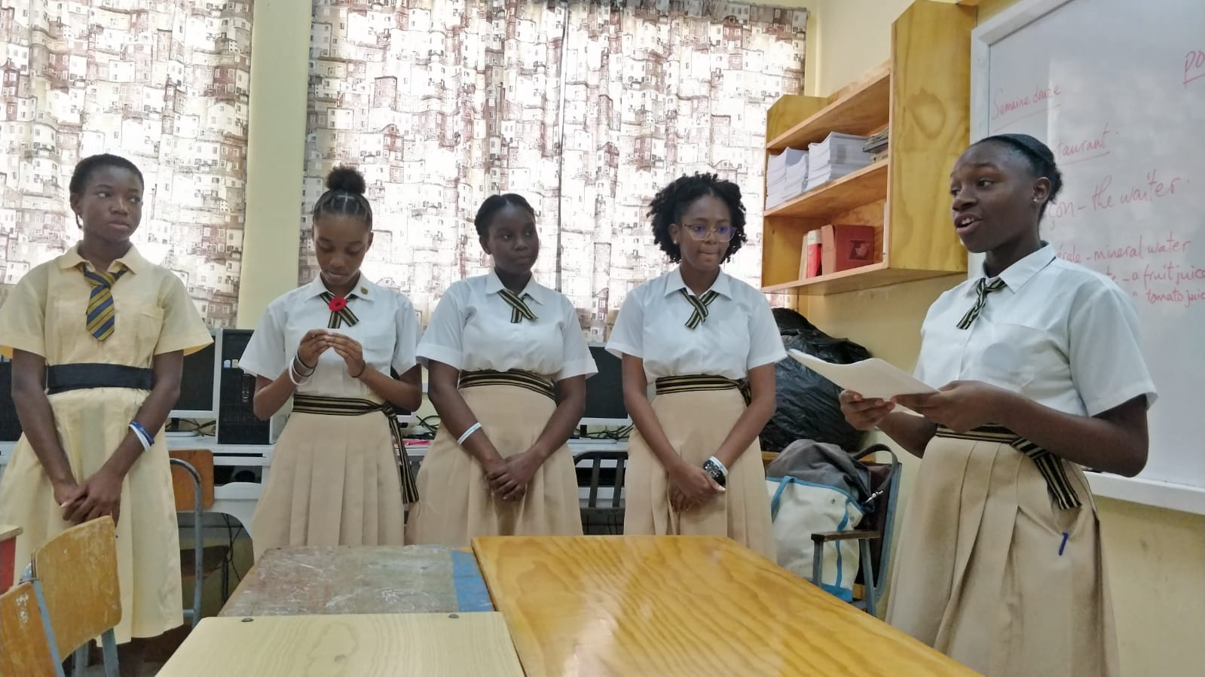
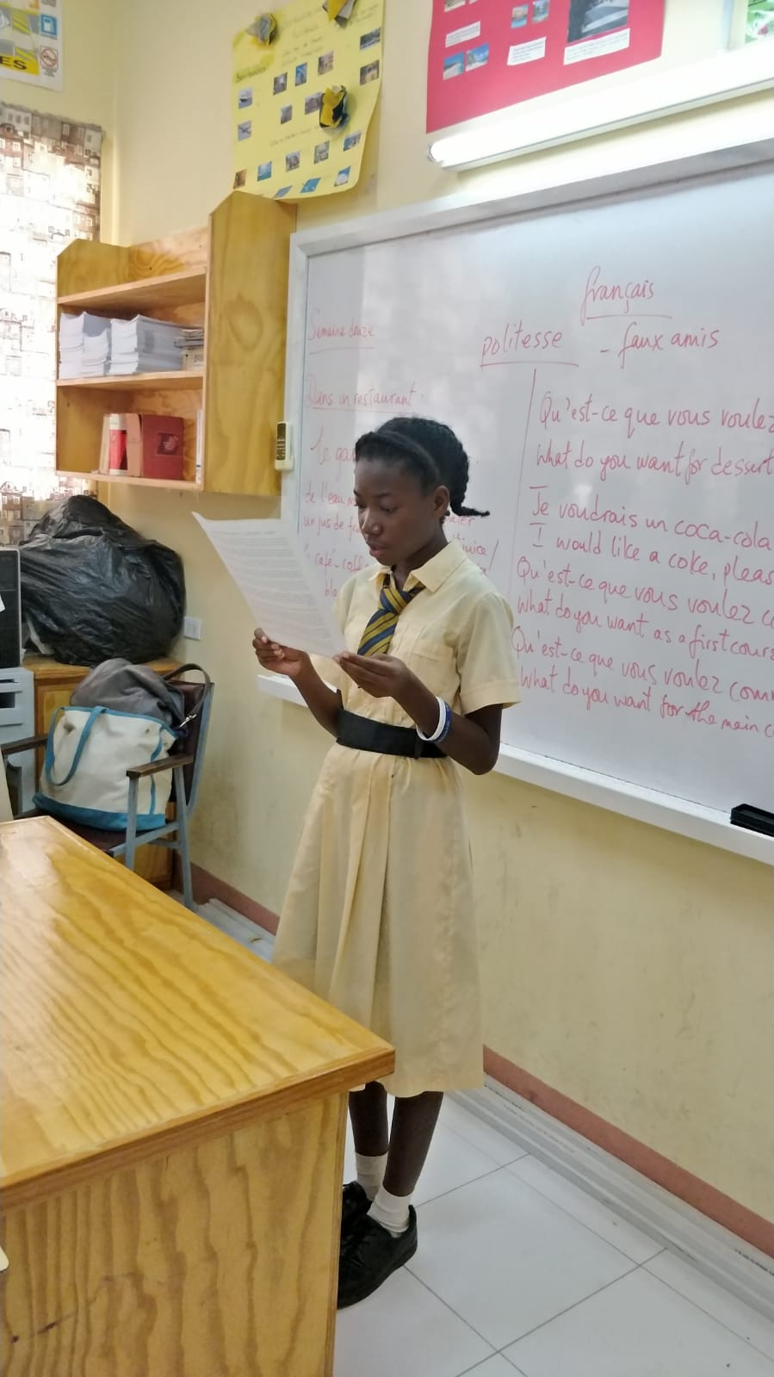
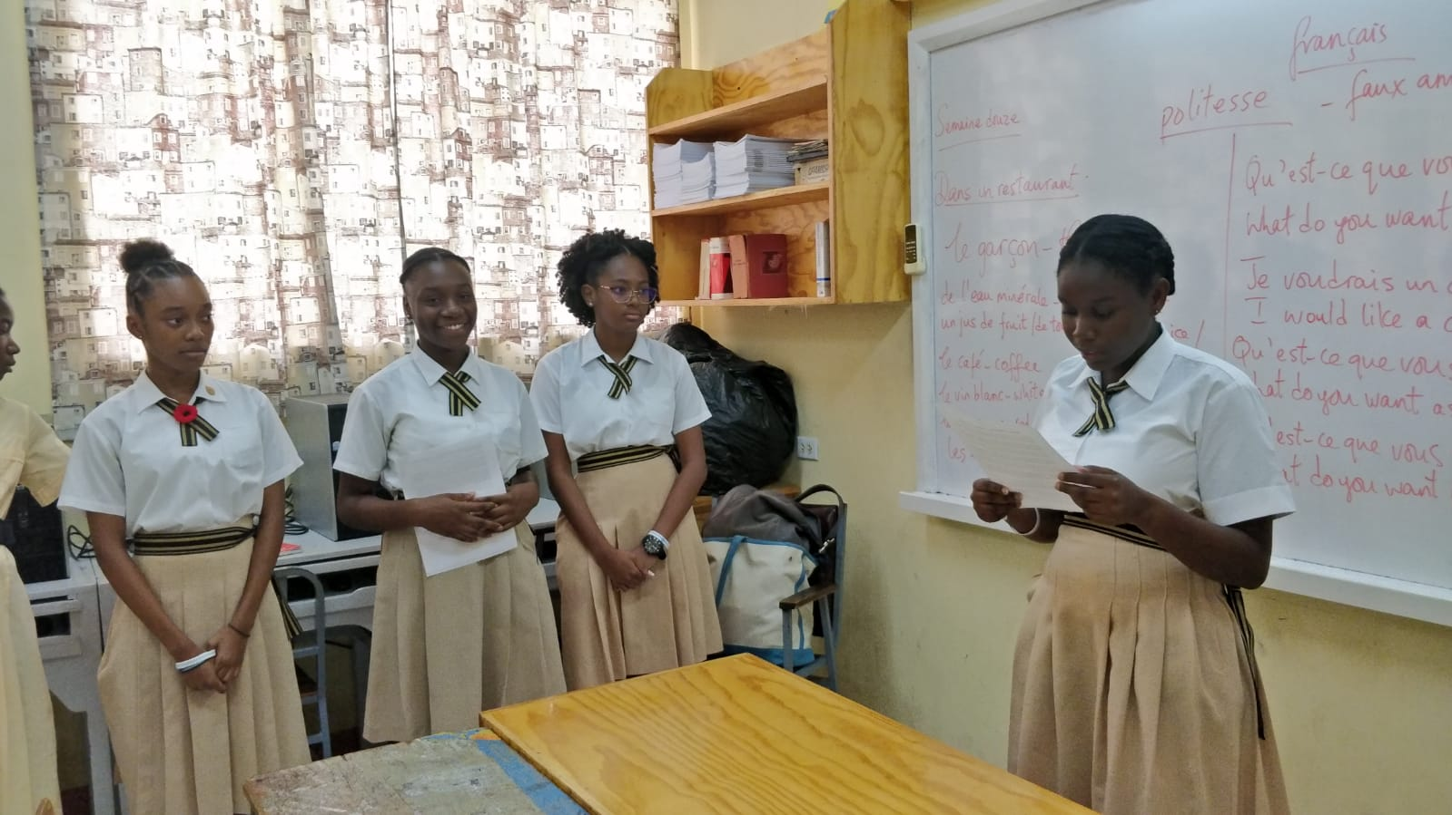
The Presentation
We presented the speech, taking turns until it was over.

Slide 6
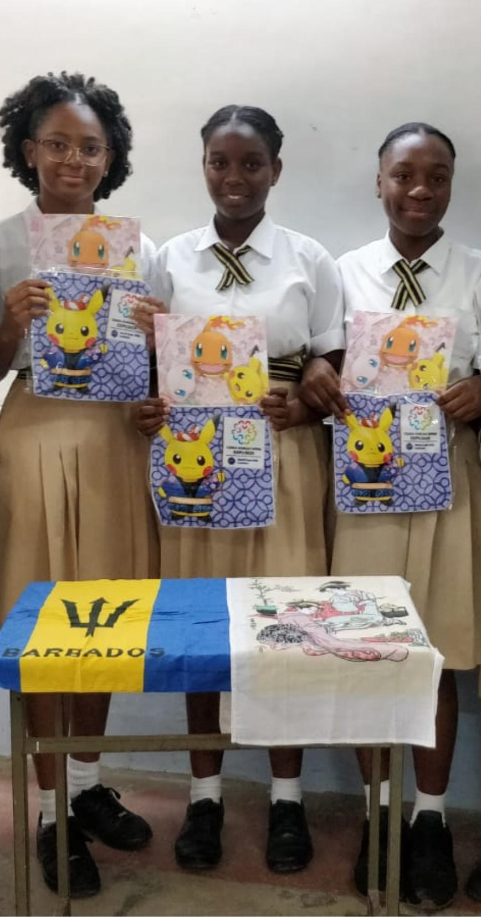
The surprise
After we had finished the presentation, a representative approached us, and as a thank you, she gave us all an envelope.
We were excited and after opening it, we were overjoyed. We had been given a wash cloth and folder for the upcoming world expo to take place in Japan. It had on very “kawaii” or cute Pokemon characters.

Slide 7
Refreshments
We moved to a classroom where the refreshments were located. We served local sweet bread and Barbadian Sorrel drink.
As we ate, we had a discussion about our goals and why we were desirous of taking part in this project.
I personally answered that I wanted to gain new friends, learn the Japanese language and culture.
As lunch time was soon at an end, we decided to take pictures and then said our goodbyes.

Slide 8
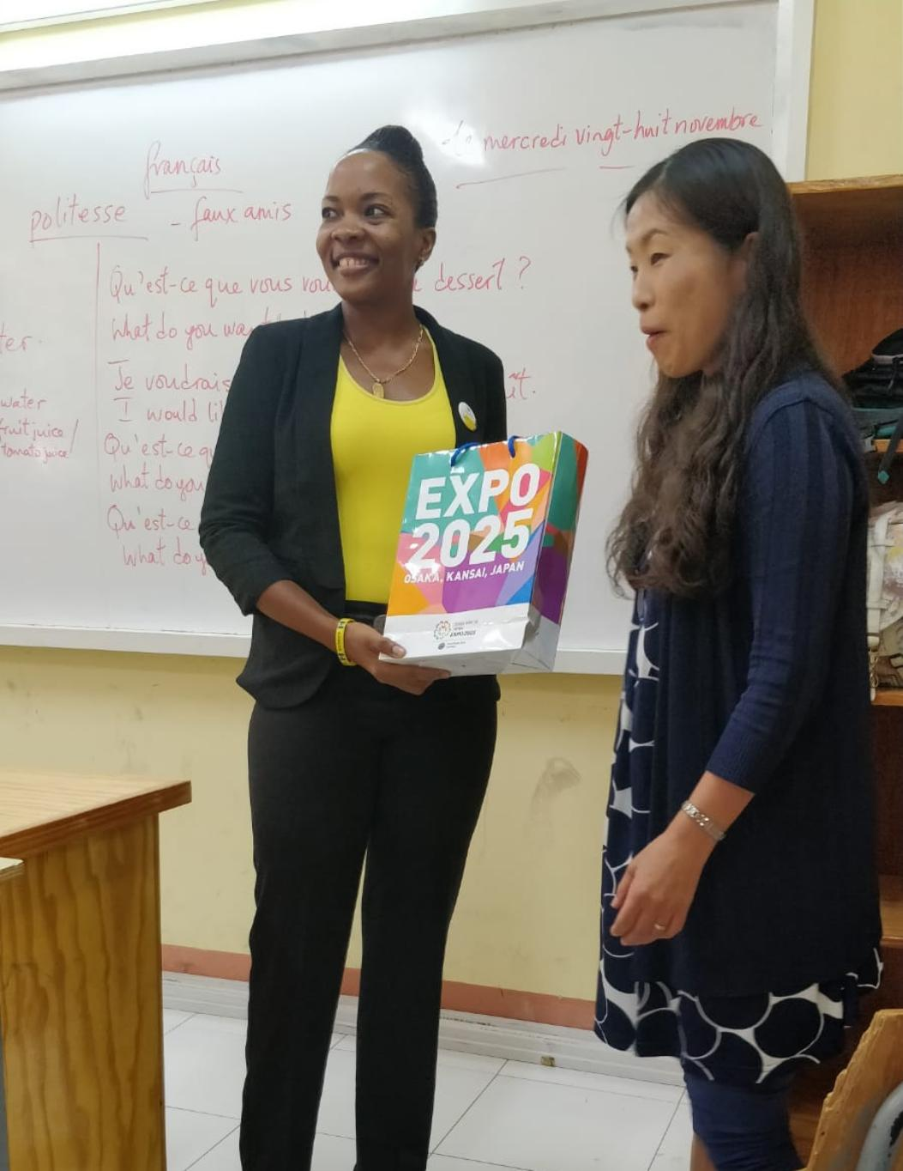
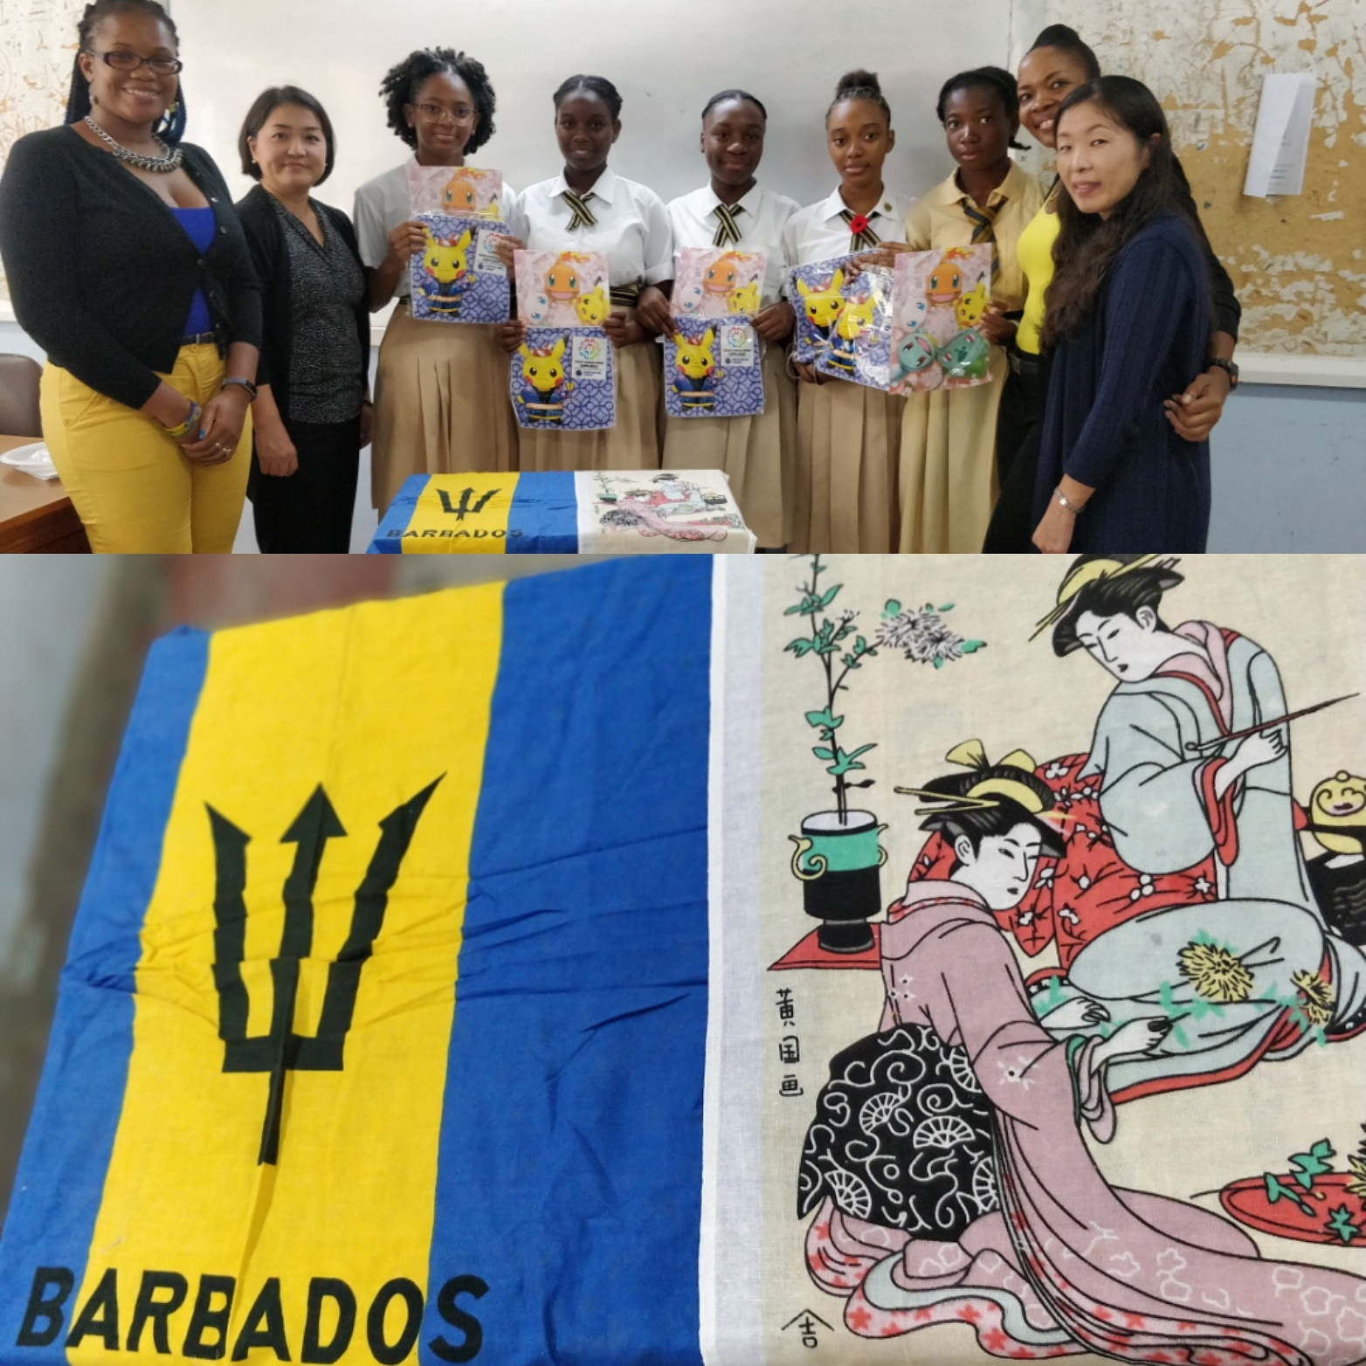
Pictures

Slide 9
Summary
It was a very fun experience. It was very nice to speak to the visiting embassy members and to hear the advice they gave us. It made me realize how real this project is and that my goals are closer to being achieved everyday.
-Presented by: Leandra Virginia Durant

