Slide 1
にほんご
Nihongo (日本語)
行きましょう

Slide 2
にほんご
Nihongo (日本語)
LESSON 7: TELLING TIME IN JAPANESE
According to Wikipedia, The Japanese numerals are the number names used in Japanese. In writing, they are the same as the Chinese numerals, and the grouping of large numbers follows the Chinese tradition of grouping by 10,000. Two pronunciations are used: the Sino-Japanese (on'yomi) readings of the Chinese characters and the Japanese yamato kotoba (native words, kun'yomi readings).

Slide 3
にほんご
Nihongo (日本語)
Basic numbering in Japanese
Wikipedia highlights the basic numbering in Japanese by stating: “There are two ways of writing the numbers in Japanese: in Arabic numerals (1, 2, 3) or in Chinese numerals (一, 二, 三). The Arabic numerals are more often used in horizontal writing, and the Chinese numerals are more common in vertical writing.”
Most numbers have two readings, one derived from Chinese used for cardinal numbers (On reading) and a native Japanese reading (Kun reading) used somewhat less formally for numbers up to 10. In some cases (listed below) the Japanese reading is generally preferred for all uses.

Slide 4
にほんご
Nihongo (日本語)

Slide 5
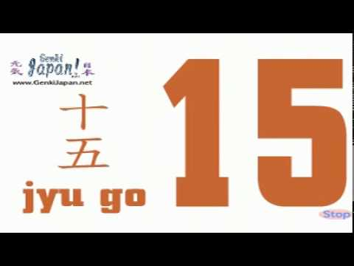
にほんご
Nihongo (日本語)

Slide 6
にほんご
Nihongo (日本語)

Slide 7
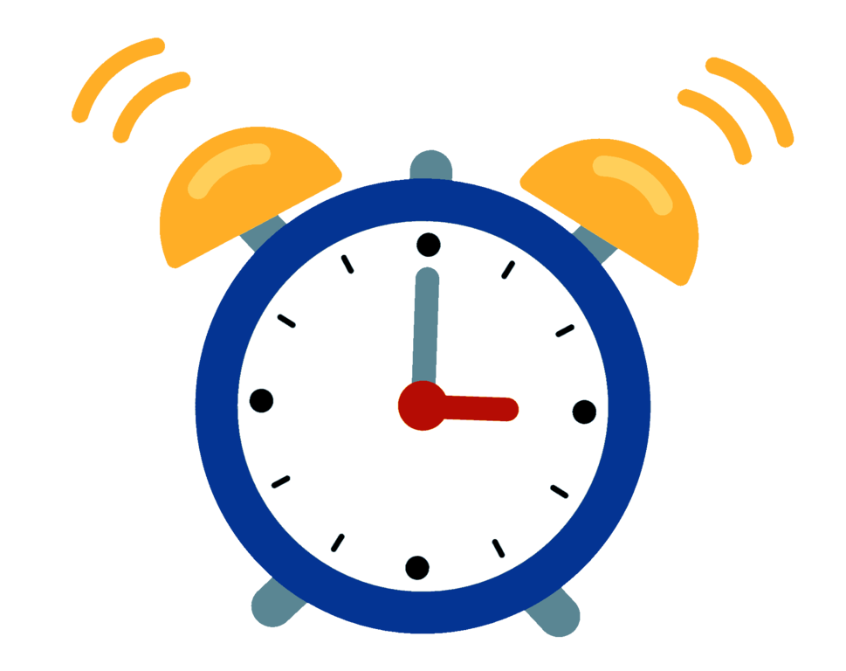
にほんご
Nihongo (日本語)
Telling time in Japanese
nanji desu ka. – What is the time? (何時 です か。) (Formal)
Ni- ji (にじ)desu. – It is two o’clock. (2 時 で)
nanji – What is the time? 何時。
San- ji (さんじ) desu. – It is three o’clock. ( 3 時 で)

Slide 8
にほんご
Nihongo (日本語)
Telling time in Japanese
nanji desu ka. – What is the time? 何時 です か。 (Formal)
yo-ji(よじ) desu. – It is four o’clock. (4 時 で)
NOTE: Although 4= よん (yon) - You cannot say yonji
Instead , you say - yo- ji(よじ) desu. – It is four o’clock. (4 時 で)

Slide 9
にほんご
Nihongo (日本語)
Telling time in Japanese
nanji desu ka. – What is the time? 何時 です か。 (Formal)
shichi (しち) - ji desu. – It is seven o’clock. (7 時 で) - USED FOR CONVERSATIONS
nanji desu ka. – What is the time? 何時 です か。 (Formal)
nana(なな )- ji desu. – It is seven o’clock. (7 時 で)- USED FOR TRAIN STATION, AIRPORT, ETC

Slide 10
にほんご
Nihongo (日本語)
Telling time in Japanese
nanji desu ka. – What is the time? 何時 です か。 (Formal)
ku-ji (くじ) desu. – It is nine o’clock. (9 時 で)
NOTE: Although 9= きゅう - You cannot say kyuji
Instead , you say - ku-ji (くじ) desu. – It is nine o’clock. (9 時 で)

Slide 11
にほんご
Nihongo (日本語) - Kanji
NOW ITS YOUR TURN : TELLING THE TIME
nanji desu ka. – What is the time? 何時 です か。
It is three o’clock - san-ji desu 三時です。
It is five o’ clock-
It is seven o’clock-
It is six o’clock-
It is eight o’clock-
It is one o’clock-

Slide 12
にほんご
Nihongo (日本語) - Kanji
NOW ITS YOUR TURN : TELLING THE TIME
nanji desu ka. – What is the time? 何時 です か。
It is three o’clock - san-ji desu (三時です)。
It is five o’ clock- go- ji desu (五時です)。
It is seven o’clock- shichi- ji desu (七時です)。
It is six o’clock- roku-ji desu (六時です)。
It is eight o’clock- hachi-ji desu (八時です)。
It is one o’clock- ichi-ji desu (一時です)。

Slide 13
にほんご
Nihongo (日本語) - Kanji

Slide 14
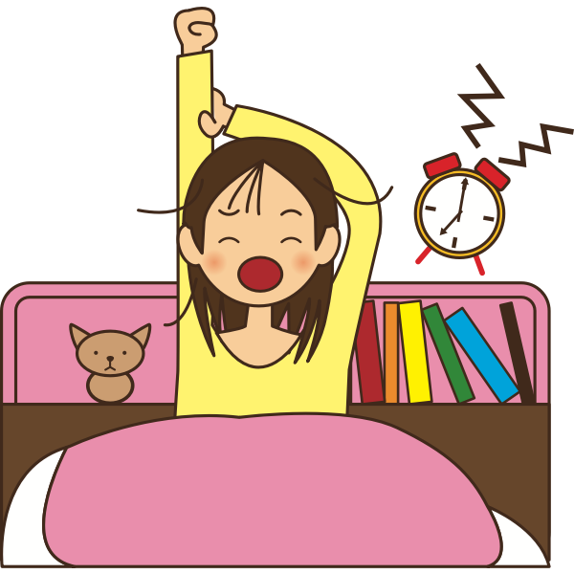
にほんご
Nihongo (日本語)
Stating an activity relating to time
If you want to say when something happens, put “ni” に after the time.
Shichi-ji ni okimasu.- I get up at 7 o’clock.
七 時 に おきます／ 起きます）。

Slide 15
にほんご
Nihongo (日本語)
Stating an activity relating to time
nanji ni okimasu ka. – What time do you get up? (何時に おきます／ 起きます) か。
Hachi-ji ni okimasu.- I get up at 8 o’clock.
八 時 に おきます／ 起きます）。

Slide 16
にほんご
Nihongo (日本語)
Stating an activity relating to time
nanji ni okimasu ka. – What time do you get up? (何時 に おきます／ 起きます) か。)
___________-ji ni okimasu.- I get up at ________ o’clock.
________ 時 に おきます／ 起きます）。

Slide 17
にほんご
Nihongo (日本語)

Slide 18
にほんご
Nihongo (日本語)
さよなら

